Slide 1
Software Engineering
Lecture #21
Fakhar Lodhi

Slide 2
Recap

Slide 3
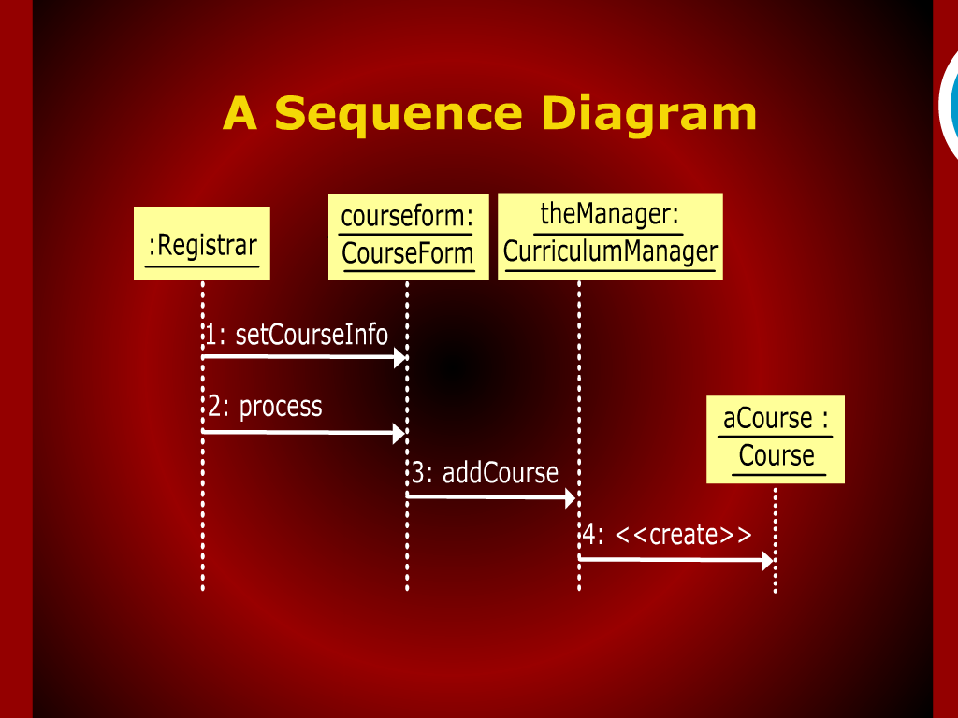
A Sequence Diagram

Slide 4
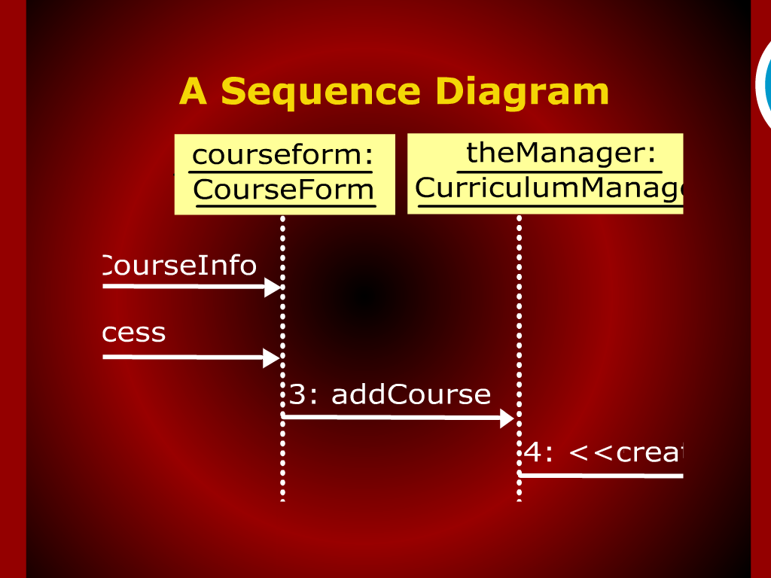
A Sequence Diagram

Slide 5
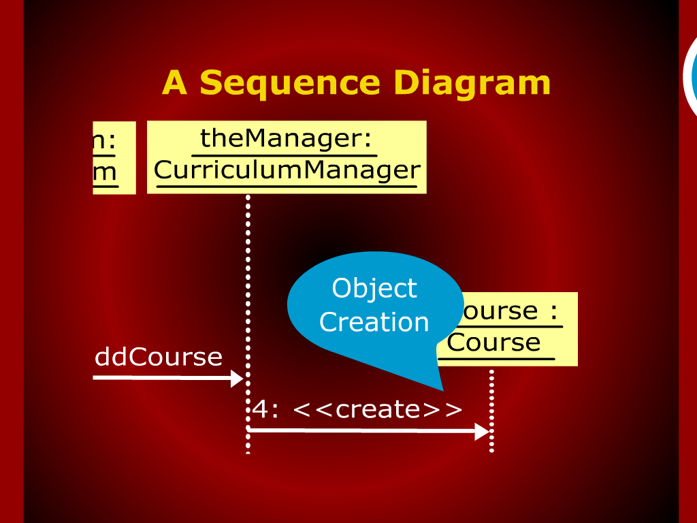
A Sequence Diagram

Slide 6
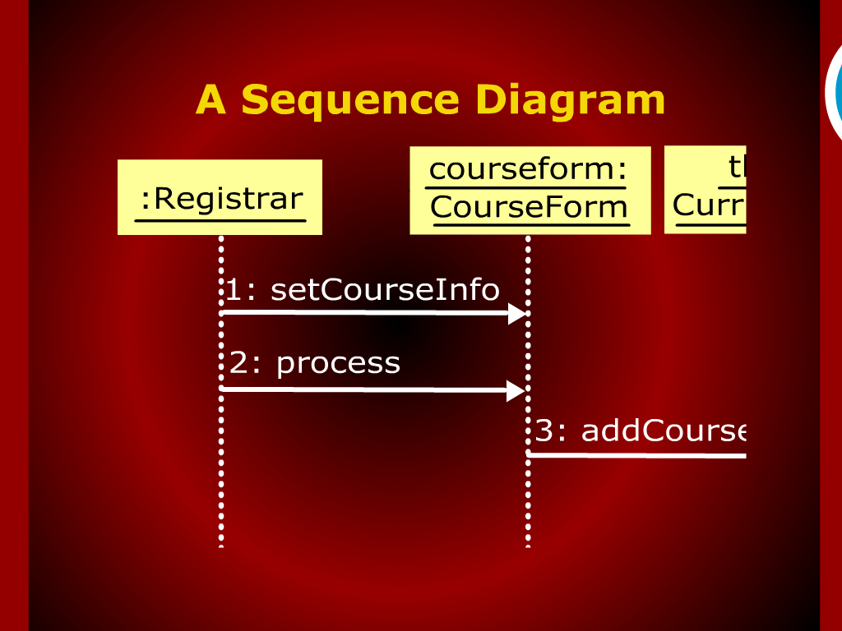
A Sequence Diagram

Slide 7
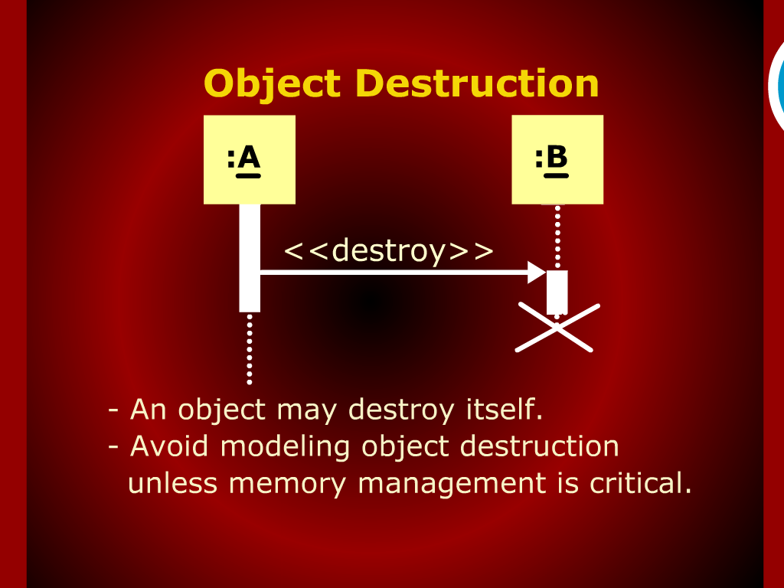
Object Destruction

Slide 8
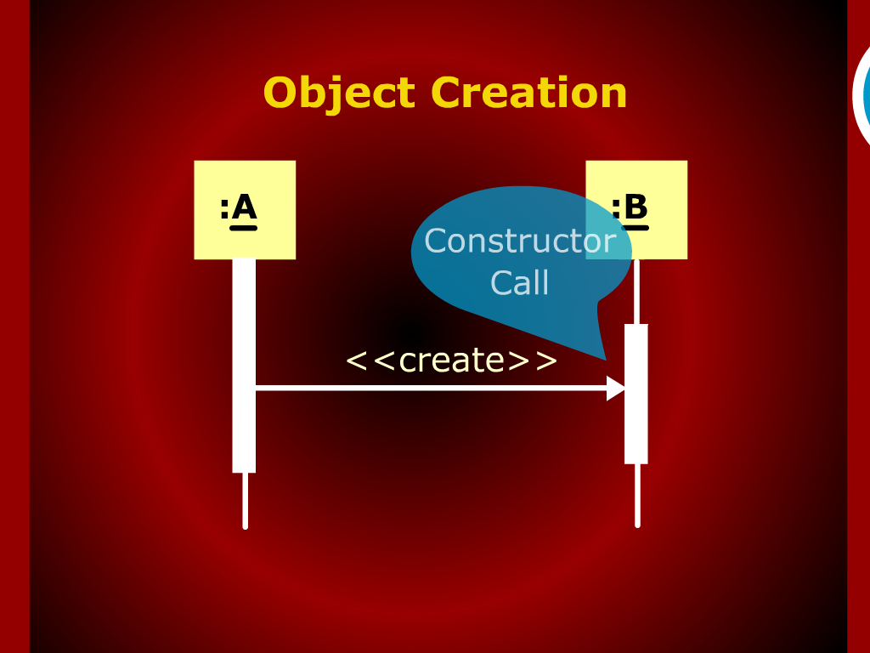
Object Creation

Slide 9
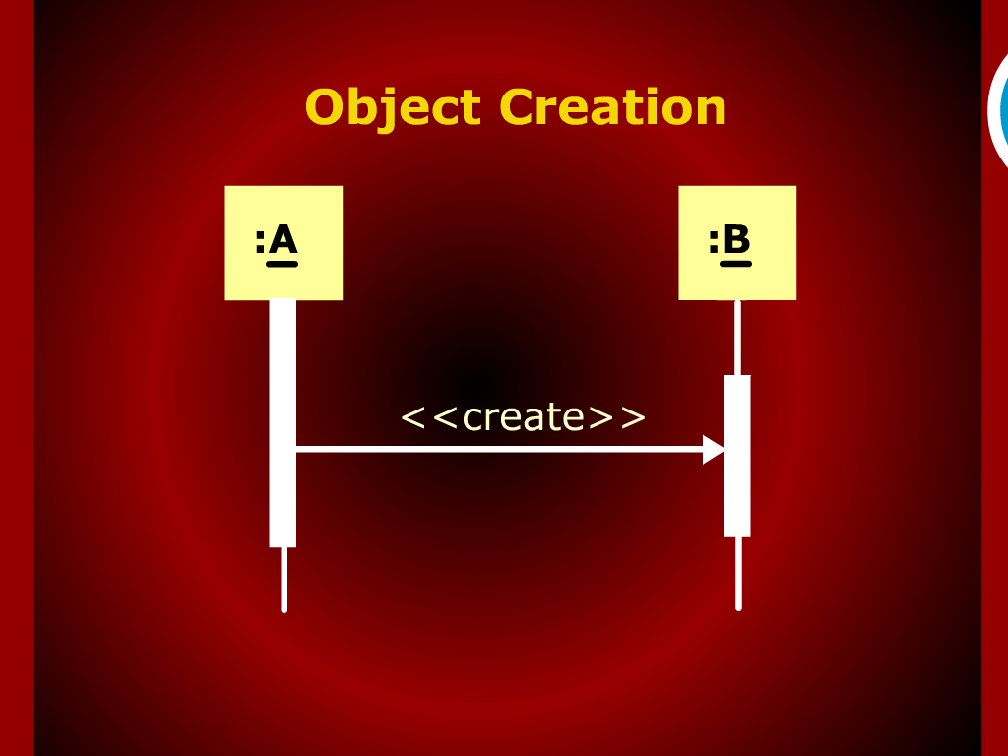
Object Creation

Slide 10
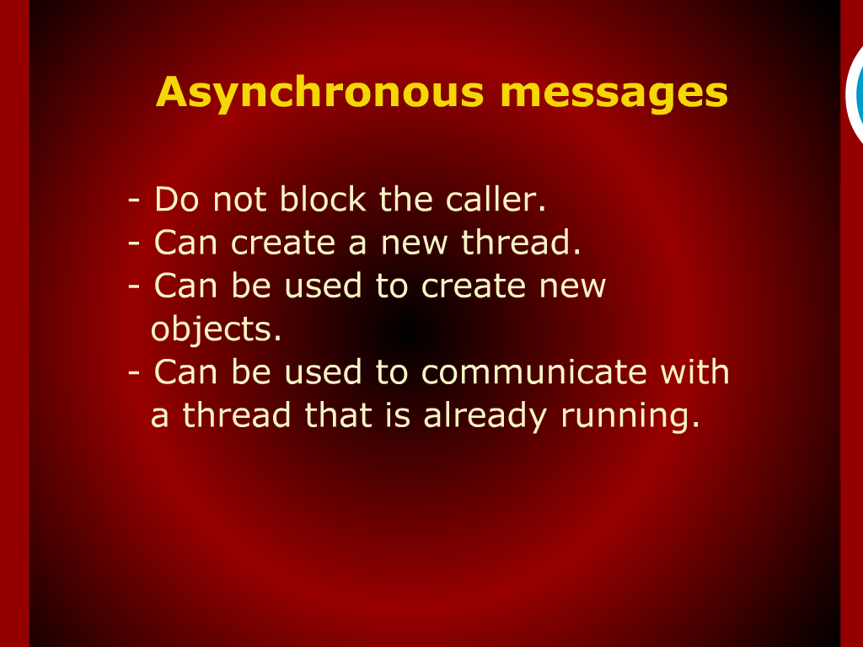
Asynchronous messages

Slide 11
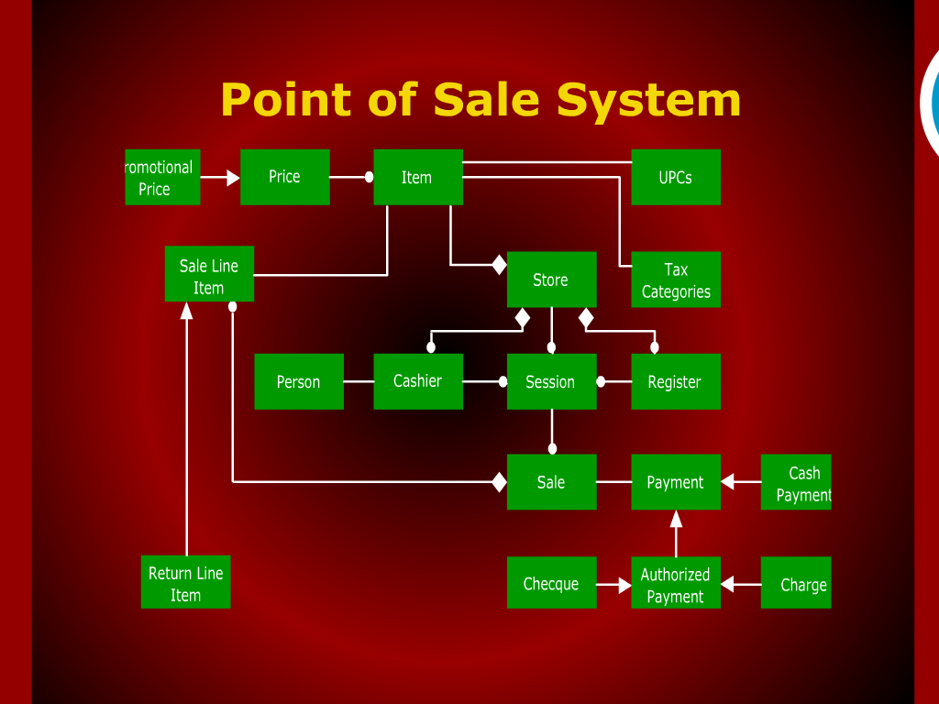
Point of Sale System

Slide 12
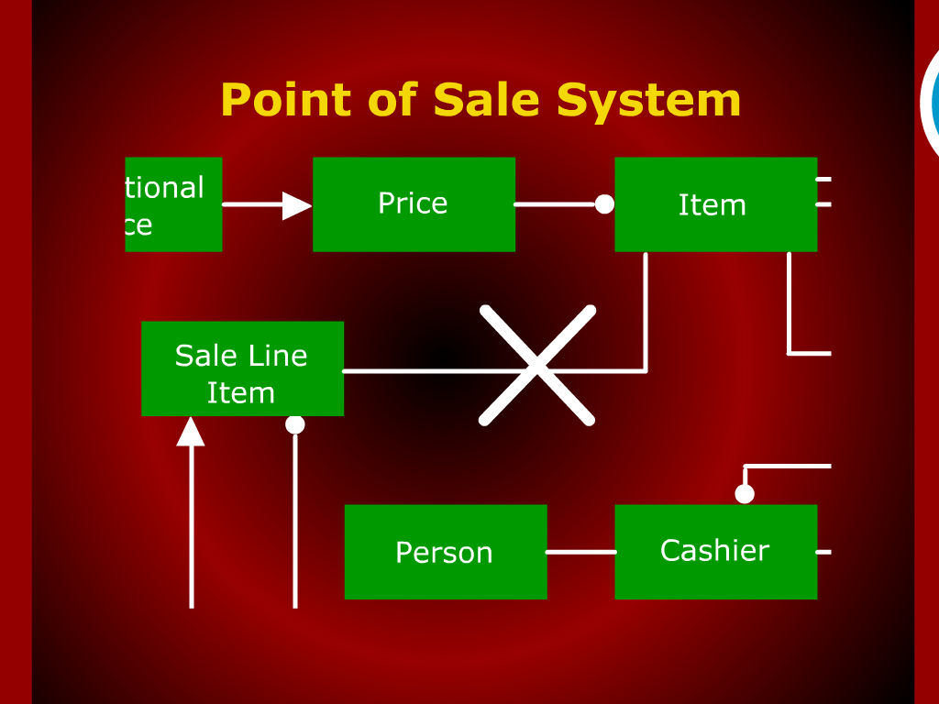
Point of Sale System

Slide 13
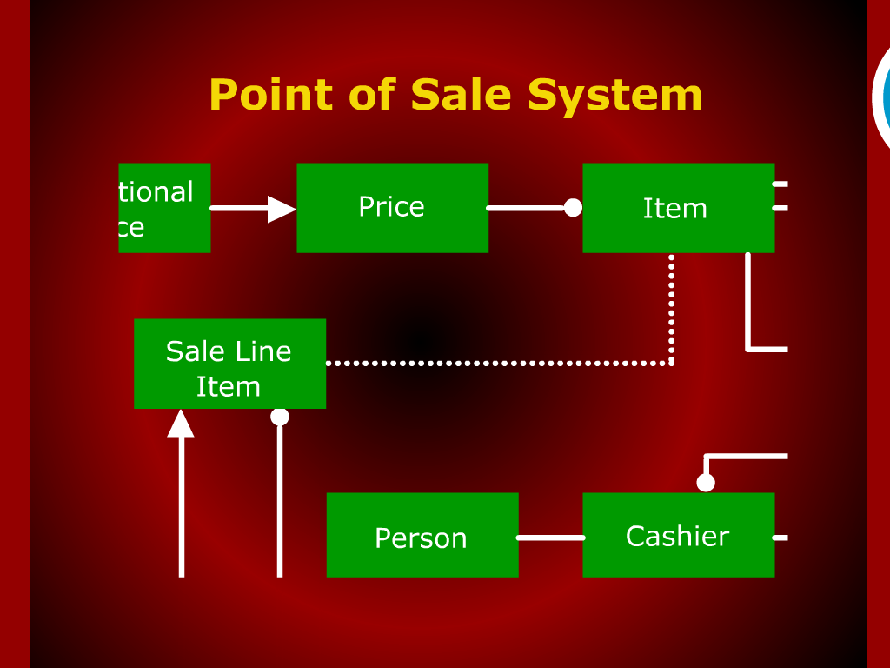
Point of Sale System

Slide 14
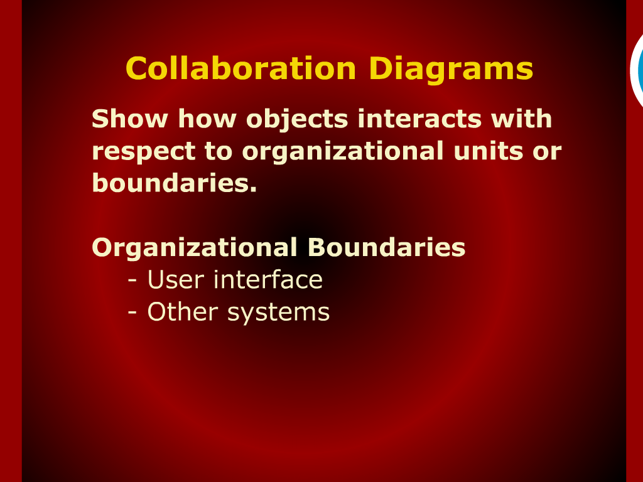
Collaboration Diagrams

Slide 15
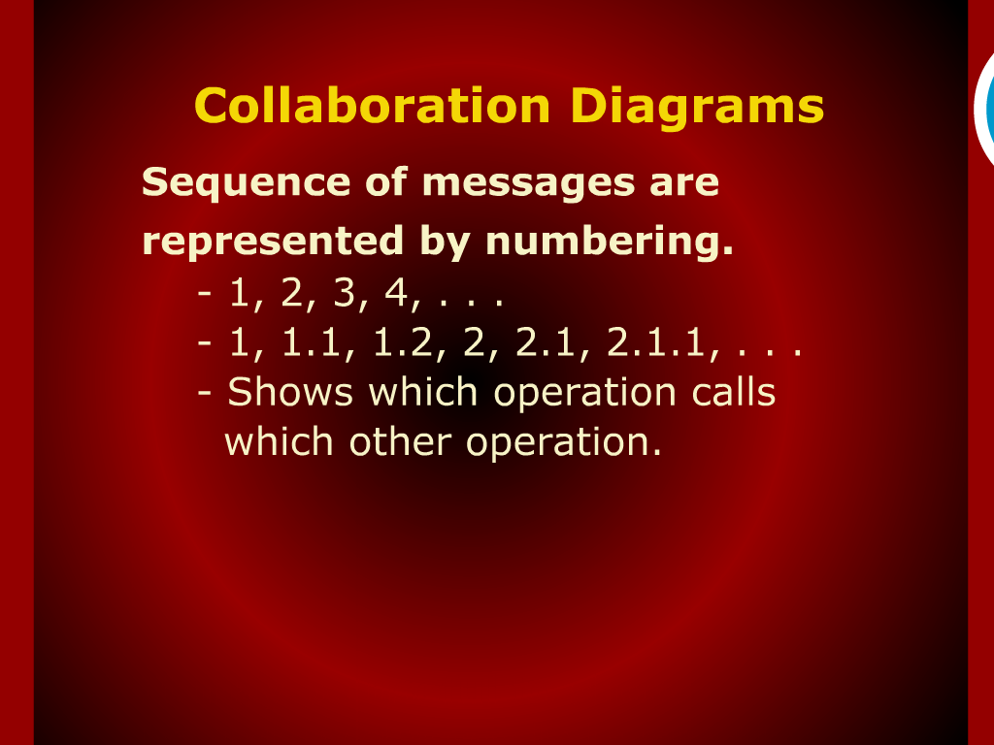
Collaborations Diagrams

Slide 16
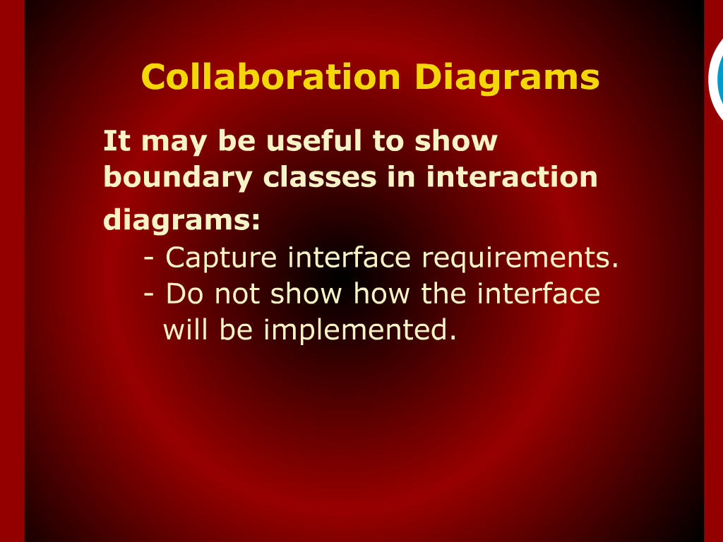
Collaboration Diagrams

Slide 17
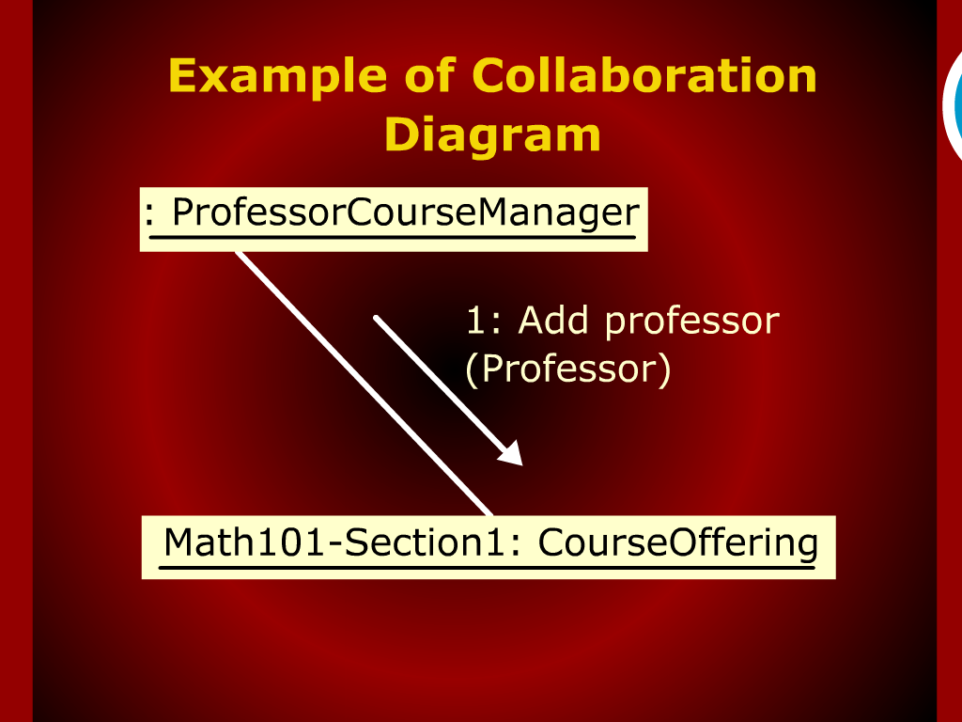
Example of Collaboration Diagram

Slide 18
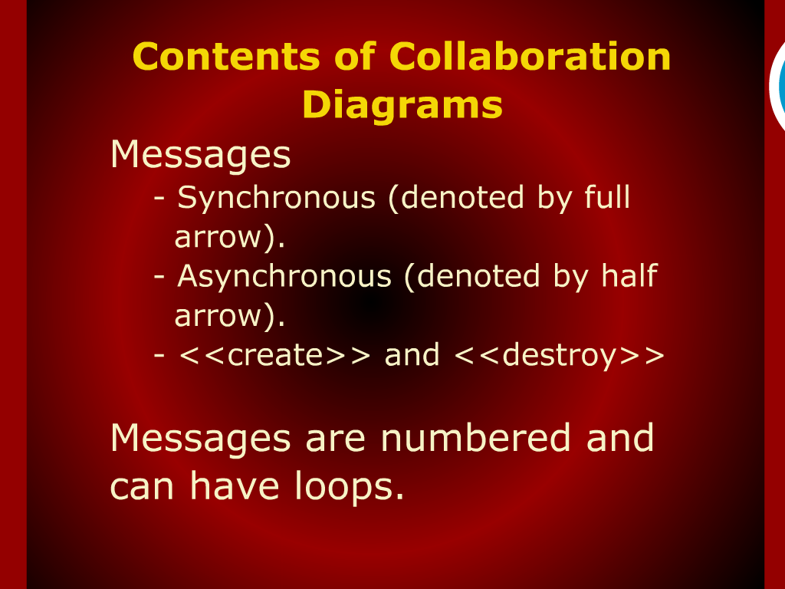
Contents of Collaboration Diagrams

Slide 19
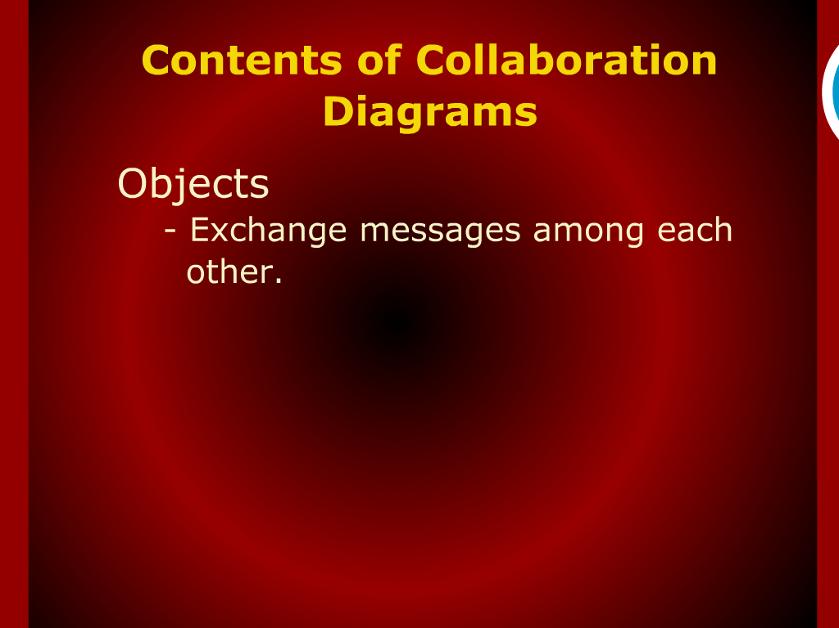
Contents of Collaboration Diagrams

Slide 20
Message

